Slide 1
Visual Auto Navigation
Group 20

Slide 2
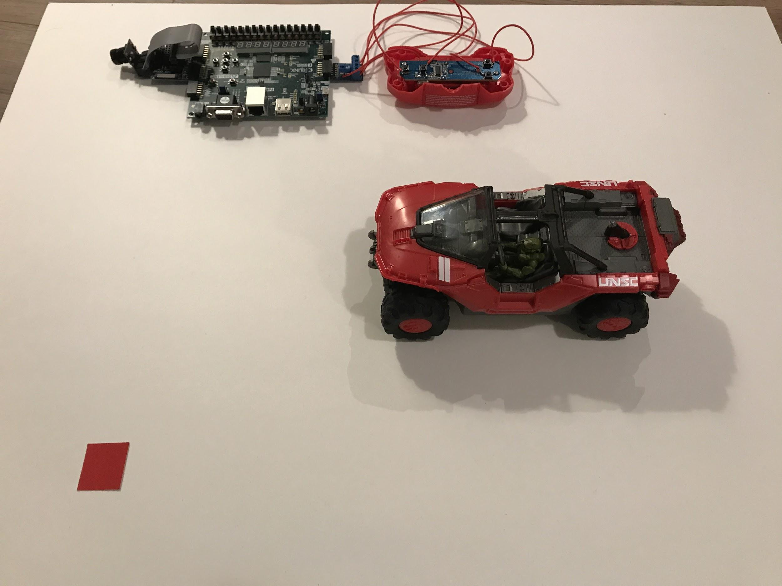
Introduction
The goal of this project was to achieve auto navigation of a remote controlled car based on visual input.
We use PMOD camera as the visual input, the FPGA will calculate the path and send control signals to the RC controller

Slide 3
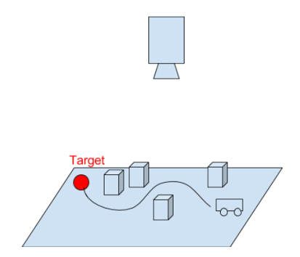
Initial Goal
Autonomous Pathfinding RC Car
Notes:
Autonomous car control system
Camera -> fpga -> car
No pathfinding now
(Lucas) In the original plan, we wanted to implement an autonomous RC car control system. In this system, a camera will feed an image of everything to the FPGA and the FPGA then will calculate a path to that the car can follow. Finally, the car would follow the path to the target without hitting the obstacles in between. The main difference is that we now don’t have a pathfinding algorithm.

Slide 4
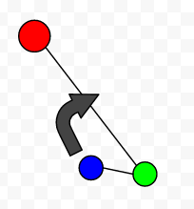
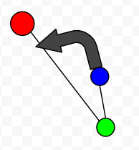
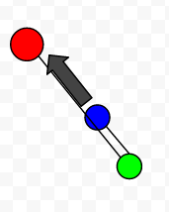
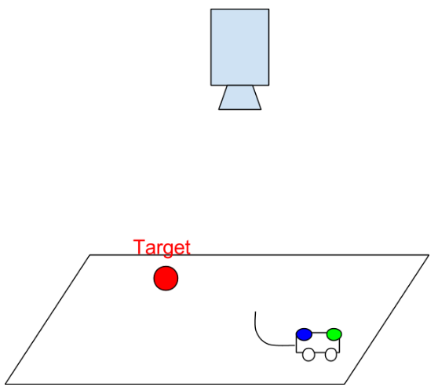
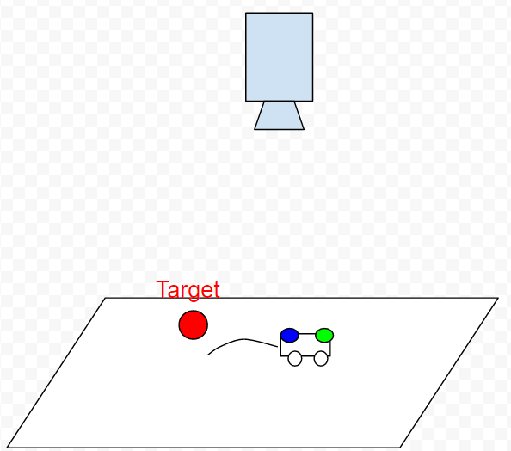
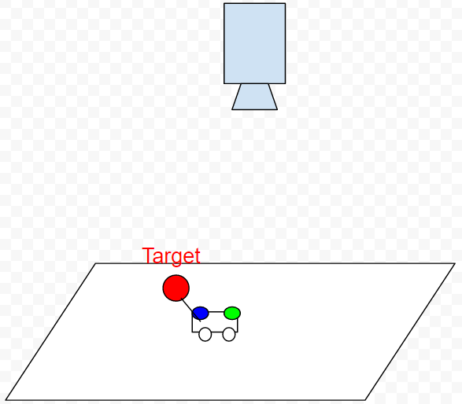
Final Product
Visual Auto Navigation
Notes:
Guided by visual feedback
Angle and distance from coordinates -> move accordingly
For example
Instead, the car is guided by visual feedback. At each step, the camera will capture the positions of the target and the car based colors. WIth the coordinates of the three points, we are able to calculate the angle formed by the three points with the tail as the vertex. Then the FPGA will move the car accordingly. For example, in the first figure, the head is left to the goal, so the car would turn right. Eventually, the car could reach the target.

Slide 5
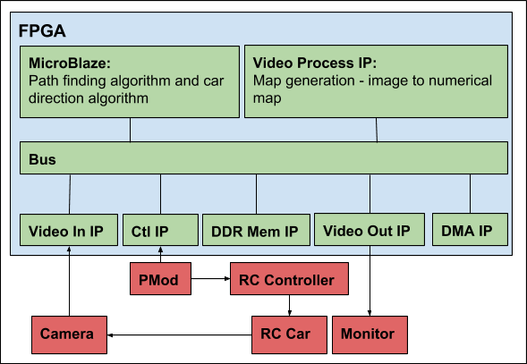
Original Block Diagram

Slide 6
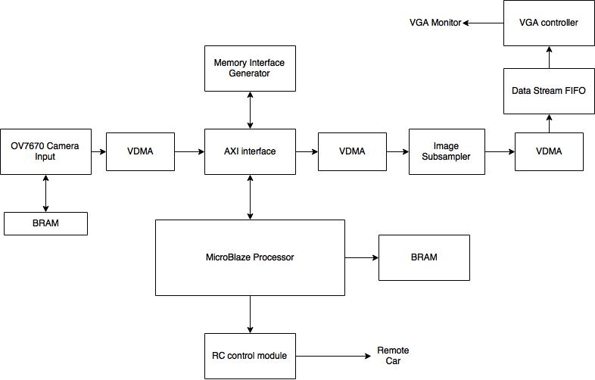
Final Block Diagram

Slide 7
Final Product
Problems
Complexity Management
Changes
Did not include the path-finding algorithm
Did not include the image overlay of determined path with
Notes:
what you ended up with
and why – what problems you had – what changes you had to make – good block diagrams will be helpful to show originally planned and resulting systems – explain the block diagram of your final system

Slide 8
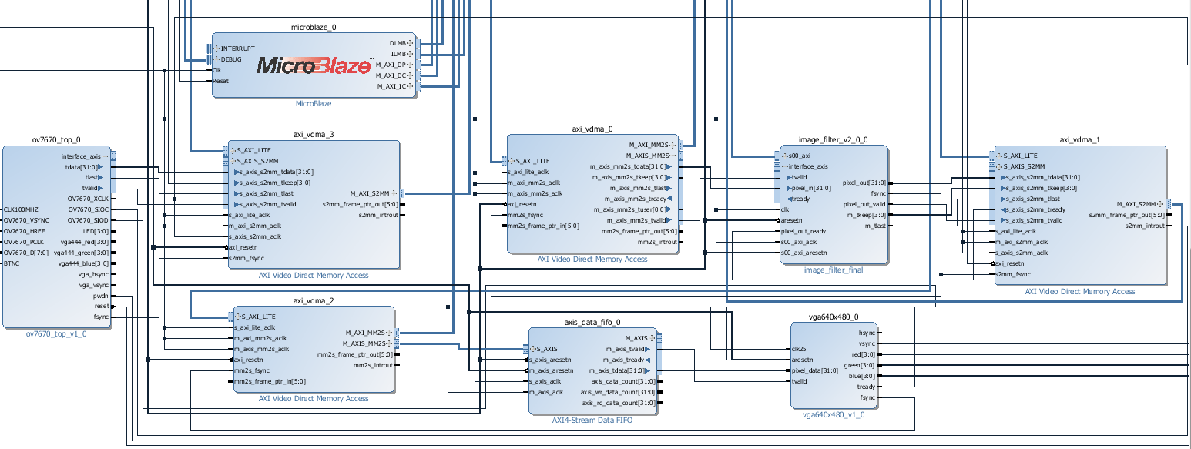
Codes / Blocks

Slide 9
Codes / Blocks
Image Subsampler (Custom):
To reduce search space and speed up marker detection
Remote car control module (Custom):
Provide a simple interface to issue commands to remote controlled car
Angle Calculator (Custom)
Calculate cos value of an angle
OV7670 Camera Block (Modified from given sample design):
Output 320x240 32-bit image (25MHz) from the camera input
Generate control signal for the next block
Have reference design from piazza resource, customized the design to meet our needs.
VGA Controller (From previous year design)
Built in Blocks: Microblaze, VDMA, Stream Fifo, Memory Interface Generator

Slide 10
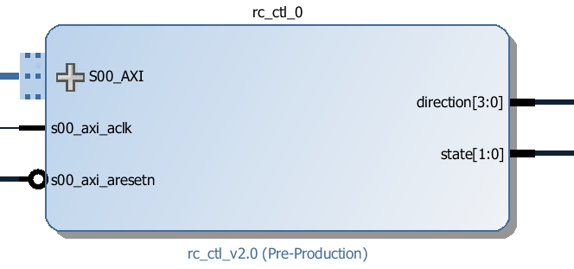
RC Car Control
Uses 5 registers
Direction reg - ← ↑ → ↓
Count reg - 1 second ≅ 100M cycles
Control reg - Send direction signal when bit0 is set to 1
State reg - RUNNING or IDEL
PostPreCount reg - Inertia problem
LED output to show current status
Output to PmodCOM which connects to the controller
Notes:
Provide a simple interface to issue commands to the rc car.
For example, 1 sec turning left
Implemented using fsm
Control reg to start a command
Count / direction reg to
The RC control module consists of 5 registers. The direction register has 4 useful bits representing up, down, left and right. The value of count register represents the time to keep a direction. For example, if we want the car to go straight for 1 sec, it’s equivalent to 100m cycles. And a control register. . With the control register, I can control the input and output of the module step by step using switches. There are two states in this system, idle and running, represented by the state register.
Lastly, there is a post-pre-count register. This count is used to prevent the effect of inertia. For example, the car would continue to move for another 3 cm after the power is off. Therefore, we need to keep the direction of the front wheels for a while after stop the forward power. And why do we need a pre count? It’s because we want the car to have a correct direction at the very first moment it starts running otherwise it might be running in a wrong direction for a little while.

Slide 11
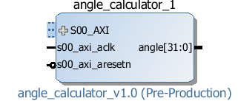
Angle Calculator
Calculate the cos value use baby step approximation and finite state machine to approximate the square root value in hardware.
The value is used as the output and then the value is used to calculate arcos to obtain the angle

Slide 12
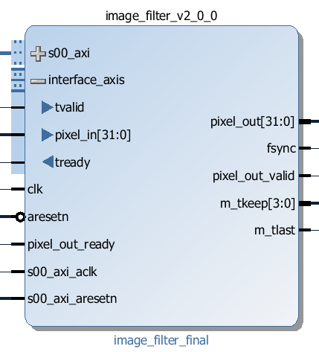
Image Subsampler
Subsamples 640x480 image to 64x48
Uses 64 flip flops, individually receiving pixels from the VDMA
Outputs 1 line of output image after receiving 10 lines of the input image
Uses min-pooling
Synchronized with VDMA through stream interface
Controlled using a Control Register through AXI-lite interface

Slide 13
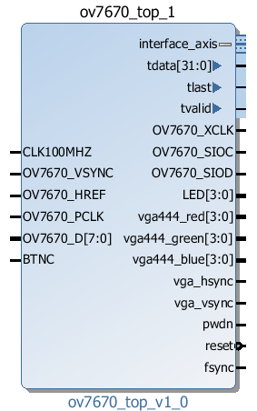
OV7670 Camera Block
Driven by 100 MHz clock source
Generated 32-bits image data flow
Generated control signal for VDMA
fsync: synchronize frame
tlast: signal of “end of line”
tvalid: data valid signal

Slide 14
Design Process
Weekly milestones are set to keep track of progress.
At the end of each week, team members reflect on progress and update milestones accordingly
Discuss with our TA on adjusting the next week’s goal and get help from our TA
Test driven development
Testbench created to verify separate components of the design
Early validation at each stage using ILA debug core

Slide 15
What we gained from the course
RTL level hardware design
High level design using IP integrator
Real time debugging using ILA debug core
Test bench and system level simulation
Macro management of a team design project
Time management

Slide 16
Demo

Slide 17
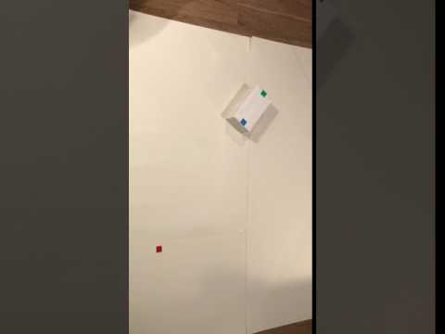
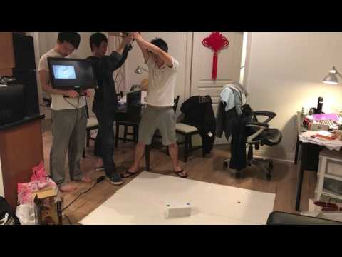
Demo

